Slide 1
Knowledge Representation Techniques

Slide 2
Knowledge Representation Techniques
Knowledge representation (KR) is an important issue in both cognitive science and artificial intelligence.
− In cognitive science, it is concerned with the way people store and process information.
− In artificial intelligence (AI), main focus is to store knowledge so that programs can process it and achieve human intelligence.

Slide 3
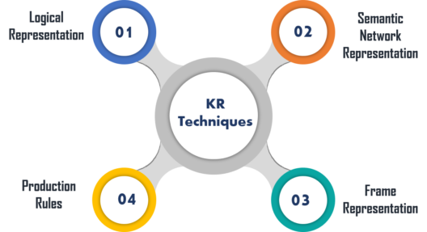
KR Techniques

Slide 4
Logical Representation
It is the most basic form of representing knowledge to machines where a well-defined syntax with proper rules is used. This syntax needs to have no ambiguity in its meaning and must deal with prepositions. Thus, this logical form of presentation acts as communication rules and is why it can be best used when representing facts to a machine.

Slide 5
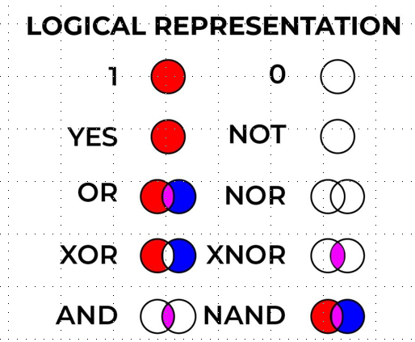

Slide 6
Logical Representation
it consists of:
1.Syntax:
Syntaxes are the rules which decide how we can construct legal sentences in the logic.
It determines which symbol we can use in knowledge representation.
How to write those symbols.
2.Semantics:
Semantics are the rules by which we can interpret the sentence in the logic.
Semantic also involves assigning a meaning to each sentence.

Slide 7
Types of Logical Representation
Propositional Logic: This type of logical representation is also known as propositional calculus or statement logic. This works in a Boolean, i.e., True or False method.
First-order Logic: This type of logical representation is also known as the First Order Predicate Calculus Logic (FOPL). This logical representation represents the objects in quantifiers and predicates and is an advanced version of propositional logic.

Slide 8
Logical Representation
Advantages:
Logical representation helps to perform logical reasoning.
This representation is the basis for the programming languages.
Disadvantages:
Logical representations have some restrictions and are challenging to work with.
This technique may not be very natural, and inference may not be very efficient.

Slide 9
Semantic Networks
Formalism for representing information about objects, people, concepts and specific relationship between them.
The syntax of semantic net is simple. It is a network of labeled nodes and links.
− It’s a directed graph with nodes corresponding to concepts, facts, objects etc. and
− arcs showing relation or association between two concepts

Slide 10
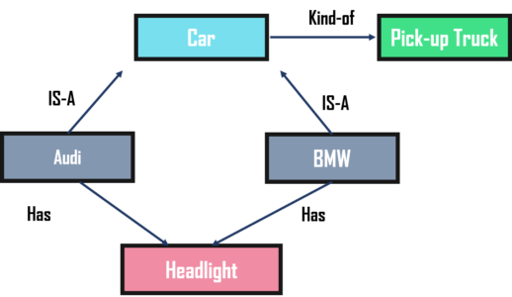
Semantic Networks
The commonly used links in semantic net are of the following types.
- isa : subclass of entity (e.g., child hospital is subclass of hospital)
- inst : particular instance of a class (e.g., India is an instance of country)
- prop : property link (e.g., property of dog is ‘bark)

Slide 11
Semantic Networks
Advantages:
Semantic networks are a natural representation of knowledge.
Also, it conveys meaning in a transparent manner.
These networks are simple and easy to understand.
Disadvantages:
Semantic networks take more computational time at runtime.
Also, these are inadequate as they do not have any equivalent quantifiers.
These networks are not intelligent and depend on the creator of the system.

Slide 12
Frame Representation
A frame is a record like structure which consists of a collection of attributes and its values to describe an entity in the world.
Frames are the AI data structure
It consists of a collection of slots and slot values. These slots may be of any type and sizes. Slots have names and values which are called facets.

Slide 13
Frame Representation
Facets: The various aspects of a slot is known as Facets.
Facets are features of frames which enable us to put constraints on the frames.
Example: IF-NEEDED facts are called when data of any particular slot is needed. A frame may consist of any number of slots, and a slot may include any number of facets and facets may have any number of values.
A frame is also known as slot-filter knowledge representation in artificial intelligence.
Frames are derived from semantic networks and later evolved into our modern-day classes and objects.

Slide 14
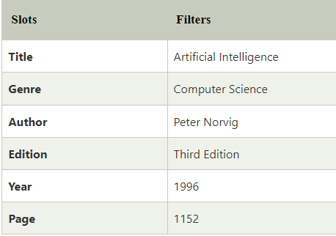
Frame Representation
Example: Let's take an example of a frame for a book

Slide 15
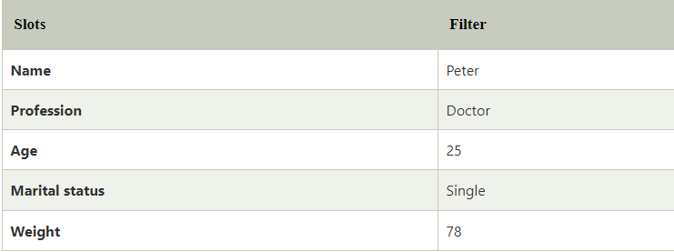
Frame Representation
Example
Let's suppose we are taking an entity, Peter. Peter is an engineer as a profession, and his age is 25, he lives in city London, and the country is England. So, following is the frame representation for this:

Slide 16
Frame Representation
Advantages of frame representation:
The frame knowledge representation makes the programming easier by grouping the related data.
The frame representation is comparably flexible and used by many applications in AI.
It is very easy to add slots for new attribute and relations.
It is easy to include default data and to search for missing values.
Frame representation is easy to understand and visualize.

Slide 17
Frame Representation
Disadvantages of frame representation:
In frame system inference mechanism is not be easily processed.
Inference mechanism cannot be smoothly proceeded by frame representation.
Frame representation has a much generalized approach.

